Slide 1
MATRICES AND DETERMINANTS

Slide 2
WHAT IS IT?
Matrix algebra is a means of making calculations upon arrays of numbers (or data).
Most data sets are matrix-type

Slide 3
WHY USE IT?
Matrix algebra makes mathematical expression and computation easier.
It allows you to get rid of cumbersome notation, concentrate on the concepts involved and understand where your results come from.

Slide 4
1.1 Matrices
Consider the following set of equations:
⎧ x + y = 7,
It is easy to show that x = 3 and y
= 4.
⎨
⎩3x − y = 5.
⎧
x + y − 2z = 7,
⎪ 2x − y − 4z = 2,
⎪
HOW ABOUT SOLVING⎨_{−5x + 4 y + 10z = 1,}
⎪
⎪⎩
3x − y − 6z = 5.
Matrices can help…

Slide 5
DEFINITIONS - SCALAR
a scalar is a number
(denoted with regular type: 1 or 22)

Slide 6
DEFINITIONS - VECTOR
Vector: a single row or column of numbers
denoted with bold small letters
Row vector
a = [1
2 3 4 5]
Column vector
⎡1⎤
b = ⎢2⎥
⎢3⎥
⎢4⎥
⎢⎣5⎥⎦

Slide 7
DEFINITIONS - MATRIX
A system of m n numbers arranged in the form of an
ordered set of m rows, each consisting of an ordered
set of n numbers, is called an m x n matrix
If there are m rows and n columns in the array, the matrix is said to be of order m x n or (m,n) or m by n
A matrix is an array of numbers
⎡a11
⎢⎣a21
a12 a13⎤
a22 a23⎦⎥
A =
Denoted with a bold Capital letter
All matrices have an order (or dimension):
that is, the number of rows × the number of columns. So, A is 2 by 3 or (2 × 3).

Slide 8


1.1 Matrices
In the matrix
^{⎡ a}11 ª12
⎢ _{a}
ª1n ⎤
a
a
⎥
2n ⎥
⎥
A = ⎢
21
22
⎢
⎢_{a}
⎥
a a
⎣ mn ⎦
m1 m 2
numbers a_{ij} are called elements. First subscript indicates the row; second subscript indicates the column. The matrix consists of mn elements
It is called “the m × n matrix A = [a_{ij}]” or simply “the matrix A ” if number of rows and columns are understood.

Slide 9
TYPES OF MATRICES
Row Matrix: An m x n matrix is called row matrix if m = 1. Ex: A = [1 2 3 4 5]
Column Matrix: An m x n matrix is called row matrix if n = 1. Ex: A = ⎡1⎤
⎢2⎥
⎢3⎥
⎢4⎥
⎢⎣5⎥⎦
Square Matrix: A square matrix is a matrix that
has the same number of rows and columns i.e. if
m = n. Ex: A =
1 2
3 4

Slide 10


TYPES OF MATRICES
Zero Matrix: A matrix each of whose elements is zero & is called a zero matrix. It is usually denoted by “O”. It is also called “Null Matrix”
⎡0 0 0⎤
⎢0 0
₀⎥
A = ⎢
⎥
⎥
⎢
⎢₀
₀⎥
⎣
0
⎦

Slide 11
TYPES OF MATRICES
Diagonal Matrix: A square matrix with its all non
diagonal elements as zero. i.e if A = [a_{ij}] is a diagonal
matrix, then = 0 whenever i ≠ j. Diagonal
ªij
elements are the a_{ij} elements of the square matrix A for which i = j.
1 | 0 | 0
0 | 2 | 0
0 | 0 | 3

Slide 12
TYPES OF MATRICES
Diagonal elements are said to constitute the main diagonal or principal diagonal or simply a diagonal.
The diagonals which lie on a line perpendicular to the diagonal are said to constitute secondary diagonal.
1 2
3 4
Here main diagonal consists of 1 & 4 and secondary
diagonal consists of 2 & 3

Slide 13
TYPES OF MATRICES
Scalar Matrix: It’s a diagonal matrix whose all elements are equal.
2 | 0 | 0
0 | 2 | 0
0 | 0 | 2
Unit Matrix: It’s a scalar matrix whose all diagonal elements are equal to unity. It is also called a Unit Matrix or Identity Matrix. It is denoted by I_{n}.
1 | 0 | 0
0 | 1 | 0
0 | 0 | 1

Slide 14
TYPES OF MATRICES
Triangular Matrix: If every element above or below the diagonal is zero, the matrix is said to be a triangular matrix.
1 4 3
0 2 1
0 0 3
Upper Triangular Matrix
1 0 0
3 2 0
5 −6 3
Lower Triangular Matrix

Slide 15
TRACE OF A MATRIX
In a square matrix A, the sum of all the diagonal elements is called the trace of A. It is denoted by tr A.
1 2 3
0 4 5
7 6 1
1 2
3 4
Ex: If A =
tr A = 1+4+1 = 6
Ex: If B =
tr B = 1+4 = 5

Slide 16
TRANSPOSE OF A MATRIX
The matrix obtained by interchanging the rows and columns of a matrix A is called the transpose of A (written as A^{T} or A` ).
2 3⎤
5
Example: ^{A = ⎡1}
⎢₄
₆⎥
⎣ ⎦
⎡1 4⎤
The transpose of A is
_{A}T
= ⎢2
₅⎥
⎢ ⎥
⎢⎣3 6⎥⎦
For a matrix A = [a_{ij}], its transpose A^{T} = [b_{ij}], where b_{ij} = a_{ji}.
34

Slide 17
SYMMETRIC & SKEW SYMMETRIC MATRICES
A matrix A such that A^{T} = A is called symmetric,
i.e., a_{ji} = a_{ij} for all i and j.
A + A^{T} must be symmetric. Why?
⎡1 2 3 ⎤
4
−5
Example: ^{A = ⎢2}
^{−5⎥} is symmetric.
⎢
⎢⎣3
⎥
6 ⎥⎦
A matrix A such that A^{T} = -A is called skew- symmetric, i.e., a_{ji} = -a_{ij} for all i and j.
A - A^{T} must be skew-symmetric. Why?
36

Slide 18
1.5 Determinants
Determinant of order 2
_{A =} ^{⎡a}11 ª12 ⎤
⎣ 21 22 ⎦
Consider a 2 × 2 matrix:
⎢_{a}
⎥
a
Determinant of A, denoted ^{| A},| is a number and can be evaluated by
ª12
22
| A |= ^{a11}
^{= a}11ª22 ^{− a}12 ª21
a a
21

Slide 19
1.5 Determinants
Determinant of order 2
easy to remember (for order 2 only)..
ª12
22
| A |= ^{a11}
^{= +a}11ª22 ^{− a}12 ª21
a a
21
-
+
1 2
4
Example: Evaluate the determinant: ₃
1
3 4
² = 1× 4 − 2 × 3 = −2

Slide 20
1.5 Determinants of order 3
⎡1 2 3⎤
5
8
Consider an example: A = ⎢4
₆⎥
⎢
⎢⎣7
⎥
9⎥⎦
Its determinant can be obtained by:
1 2 3
A = 4 5 6 = 3 ⁴
7 8 9
5 ₋ ₆ 1 2 ₊ ₉ 1 2
7 8 7 8 4 5
= 3(−3) − 6(−6) + 9(−3) = 0

Slide 21
1.5 Determinants
The following properties are true for determinants of any order.
1. If every element of a row (column) is zero, e.g., ¹ ² = 1× 0 − 2 × 0 = 0 , then |A| = 0.
0 0
determinant of a matrix
= that of its transpose
2. |A^{T}| = |A|
3. |AB| = |A||B|

Slide 22
1.3 Types of matrices
Orthogonal matrix
A matrix A is called orthogonal if AA^{T} = A^{T}A = I, i.e., A^{T} = A⁻¹
⎡1/ 3 1/ 6 −1/
3 −2 / 6 0
3 1/ 6 1/
2 ⎤
⎢
⎥
Example: prove that ^{A =} ⎢^{1/}
⎥is
orthogonal.
⎢
⎥
⎢⎣1/
2 ⎥⎦
⎡ 1/ 3 1/ 3 1/
⎢
= ⎢ 1/ 6 −2 / 6 1/
2 0 1/
3 ⎤
Since, A^{T}
⎥
6.⎥ Hence, AA^{T} = A^{T}A = I.
₂ ⎥
⎢−1/
⎢⎣
⎥⎦
We’ll see that orthogonal matrix represents a rotation in fact!

Slide 23
1.4 Properties of matrix
(AB)⁻¹ = B⁻¹A⁻¹
(A^{T})^{T} = A and (λA)^{T} = λ A^{T}
(A + B)^{T} = A^{T} + B^{T}
(AB)^{T} = B^{T} A^{T}

Slide 24
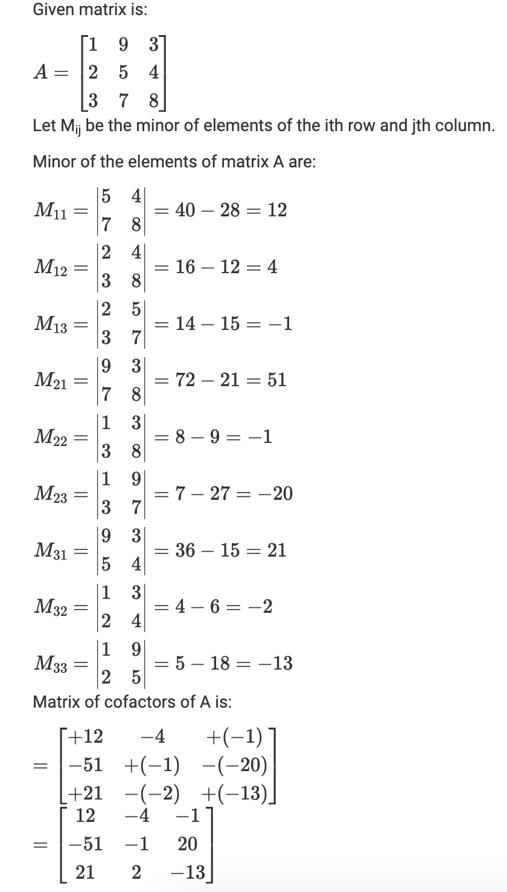
Cofactor Matrix
A cofactor is a number that is obtained by eliminating the row and column of a particular element which is in the form of a square or rectangle. The cofactor is preceded by a negative or positive sign based on the element’s position.

Slide 25
Adjoint of a Matrix
It is defined as the transpose of the cofactor matrix

Slide 26
INVERSE OF A MATRIX
Let A be any square matrix of order n. The n- square matrix B of the same order is called the inverse of A if AB = BA = I.
It is denoted by A⁻¹ or B = A⁻¹
The necessary & sufficient condition for finding inverse is that the matrix must be a non- singular matrix i.e. its determinant is not equal to zero.
_{A-1 =} 𝐴𝑑𝑗.𝐴_{; 𝐴}
≠ 0
𝐴

Slide 27
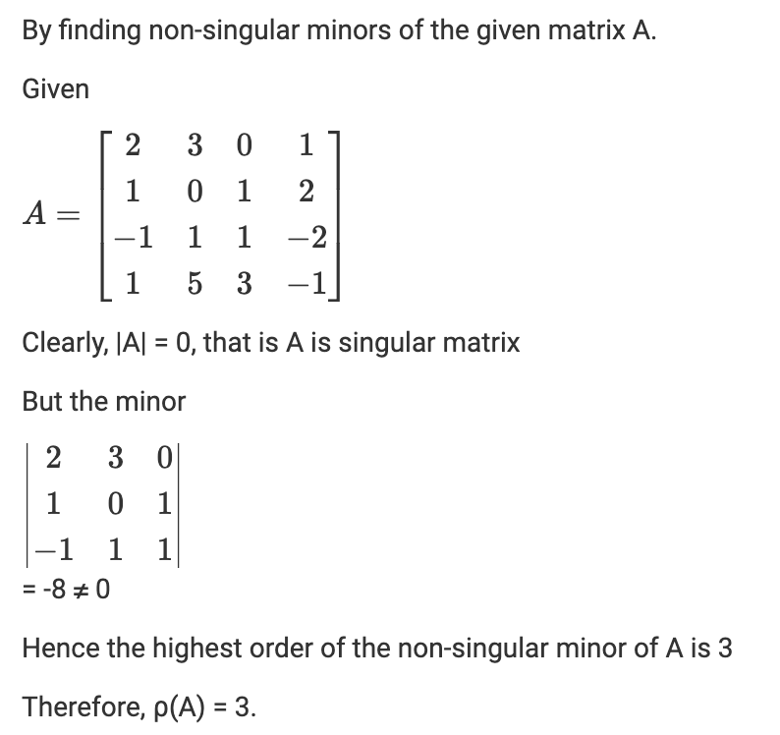
Rank of a Matrix
The highest order of non-zero minor of a matrix is said to be the rank of a matrix. If ‘r’ is the rank of the matrix then at least one minor of the given matrix is of order r and all other minors of order greater than r is zero.

Slide 28
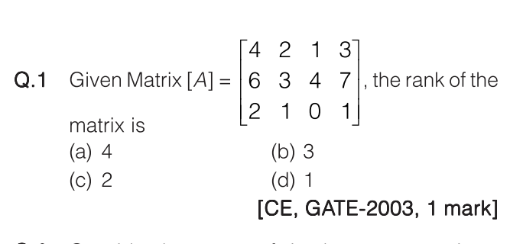
Previous Year Gate Questions

Slide 29
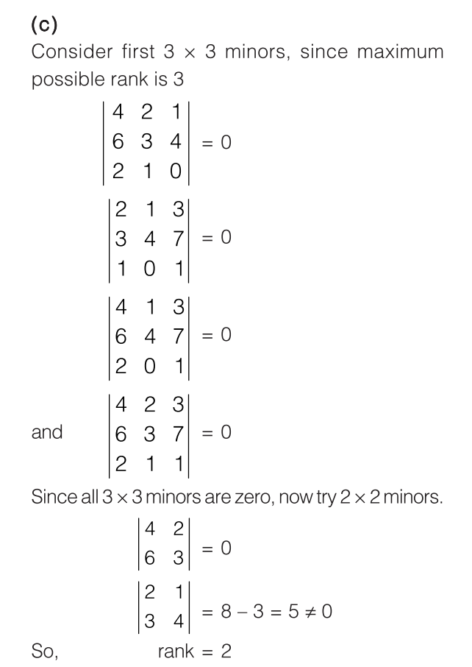

Slide 30
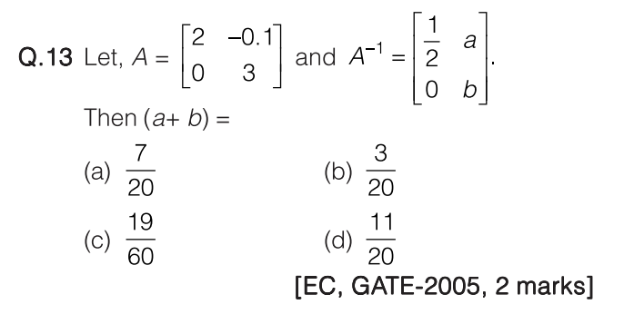

Slide 31
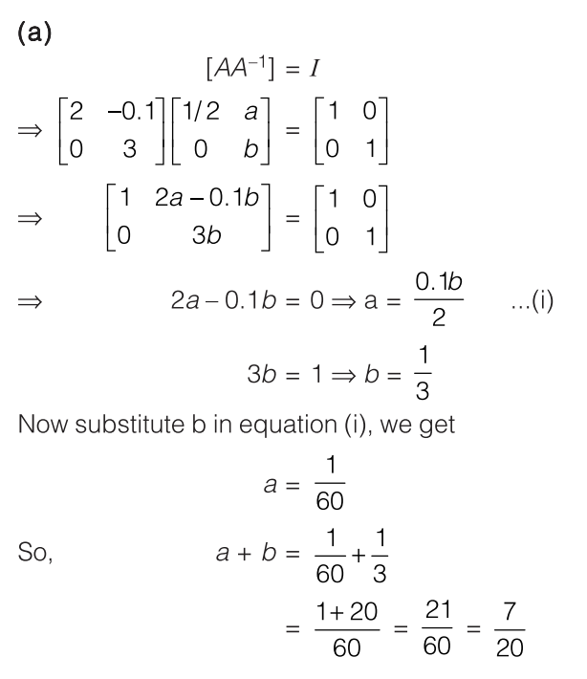

Slide 32
Eigen values and Eigen Vectors

Slide 33
Eigenvalues - Introduction
Eigenvalues are associated with eigenvectors in Linear algebra. Both terms are used in the analysis of linear transformations. Eigenvalues are the special set of scalar values that is associated with the set of linear equations in the matrix equations. The eigenvectors are also termed as characteristic roots. It is a non-zero vector that can be changed at most by its scalar factor after the application of linear transformations. And the corresponding factor which scales the eigenvectors is called an eigenvalue.

Slide 34
Eigenvector - Introduction
The eigenvector is a vector that is associated with a set of linear equations. The eigenvector of a matrix is also known as a latent vector, proper vector, or characteristic vector. These are defined in the reference of a square matrix. Eigenvectors are also useful in solving differential equations and many other applications related to them.

Slide 35
Definition
Eigenvalues are the special set of scalars associated with the system of linear equations. It is mostly used in matrix equations. The term eigenvalue can be termed as characteristic value, characteristic root, proper values or latent roots as well. In simple words, the eigenvalue is a scalar that is used to transform the eigenvector. The basic equation is
Ax = λx
The number or scalar value “λ” is an eigenvalue of A.
In Mathematics, an eigenvector corresponds to the real non zero eigenvalues which point in the direction stretched by the transformation whereas eigenvalue is considered as a factor by which it is stretched. In case, if the eigenvalue is negative, the direction of the transformation is negative.
For every real matrix, there is an eigenvalue. Sometimes it might be complex. The existence of the eigenvalue for the complex matrices is equal to the fundamental theorem of algebra.

Slide 36
Eigenvalues of a Square Matrix
Suppose, A_{n×n} is a square matrix, then [A- λI] is called an Eigen or characteristic matrix, which is an indefinite or undefined scalar. Where determinant of Eigen matrix can be written as, |A- λI| and |A- λI| = 0 is the Eigen equation or characteristics equation, where “I” is the identity matrix. The roots of an Eigen matrix are called Eigen roots.
Eigenvalues of a triangular matrix and diagonal matrix are equivalent to the elements on the principal diagonals. But eigenvalues of the scalar matrix are the scalar only.

Slide 37
Properties of Eigenvalues
Eigenvectors with Distinct Eigenvalues are Linearly Independent
Singular Matrices have Zero Eigenvalues
If A is a square matrix, then λ = 0 is not an eigenvalue of A
For a scalar multiple of a matrix: If A is a square matrix and λ is an eigenvalue of A. Then, aλ is an eigenvalue of aA.
For Matrix powers: If A is square matrix and λ is an eigenvalue of A and n≥0 is an integer, then λ^{n} is an eigenvalue of A^{n}.
For polynomials of matrix: If A is a square matrix, λ is an eigenvalue of A and p(x) is a polynomial in variable x, then p(λ) is the eigenvalue of matrix p(A).
Inverse Matrix: If A is a square matrix, λ is an eigenvalue of A, then λ⁻¹ is an eigenvalue of A⁻¹
Transpose matrix: If A is a square matrix, λ is an eigenvalue of A, then λ is an eigenvalue of A^{t}

Slide 38
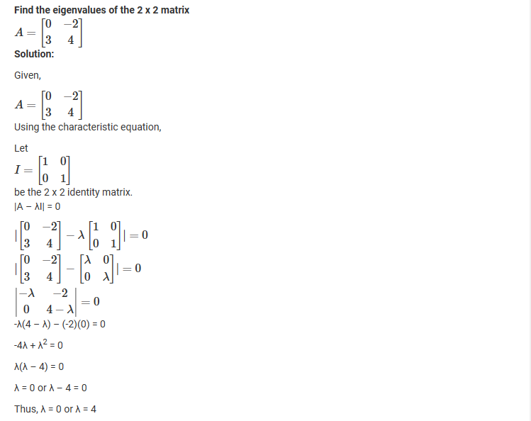
Examples

Slide 39

Previous Gate Questions
1. GATE 2016

Slide 40
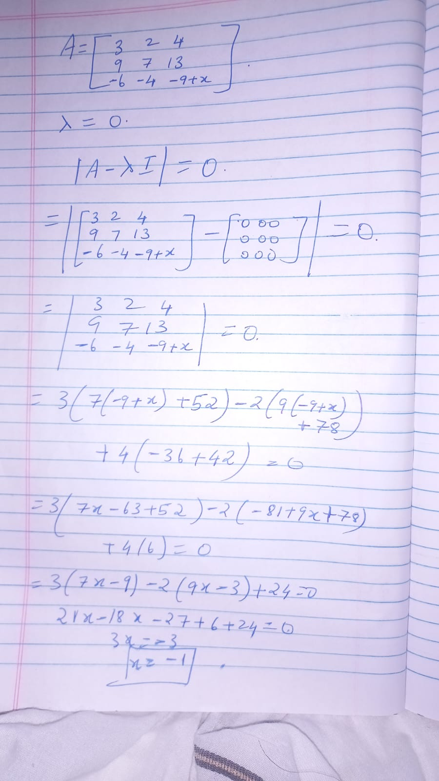
Answer:

Slide 41
Eigenvector
Eigenvector of a square matrix is defined as a non-vector in which when a given matrix is multiplied, it is equal to a scalar multiple of that vector. Let us suppose that A is an n x n square matrix, and if v be a non-zero vector, then the product of matrix A, and vector v is defined as the product of a scalar quantity λ and the given vector, such that:
Av =λv
Where
v = Eigenvector and λ be the scalar quantity that is termed as eigenvalue associated with given matrix A

Slide 42
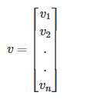
Finding Eigenvector
The method of determining the eigenvector of a matrix is given as follows:
If A be an n×n matrix and λ be the eigenvalues associated with it. Then, eigenvector v can be defined by the following relation: Av =λv
If “I” be the identity matrix of the same order as A, then
(A – λI)v =0
The eigenvector associated with matrix A can be determined using the above method.

Slide 43
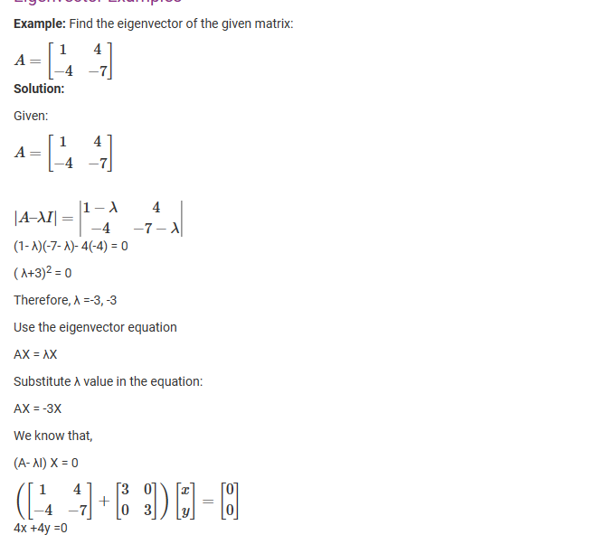
Example

Slide 44
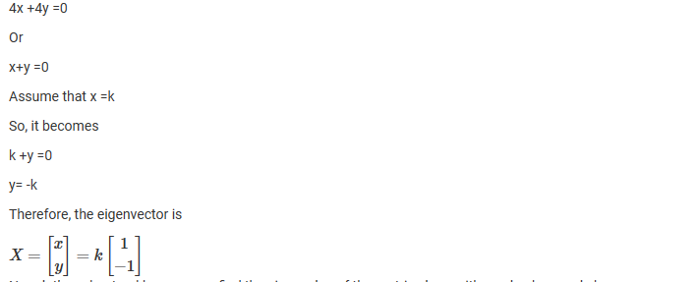

Slide 45
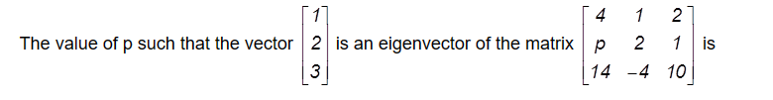
Previous year Questions
GATE 2018

Slide 46
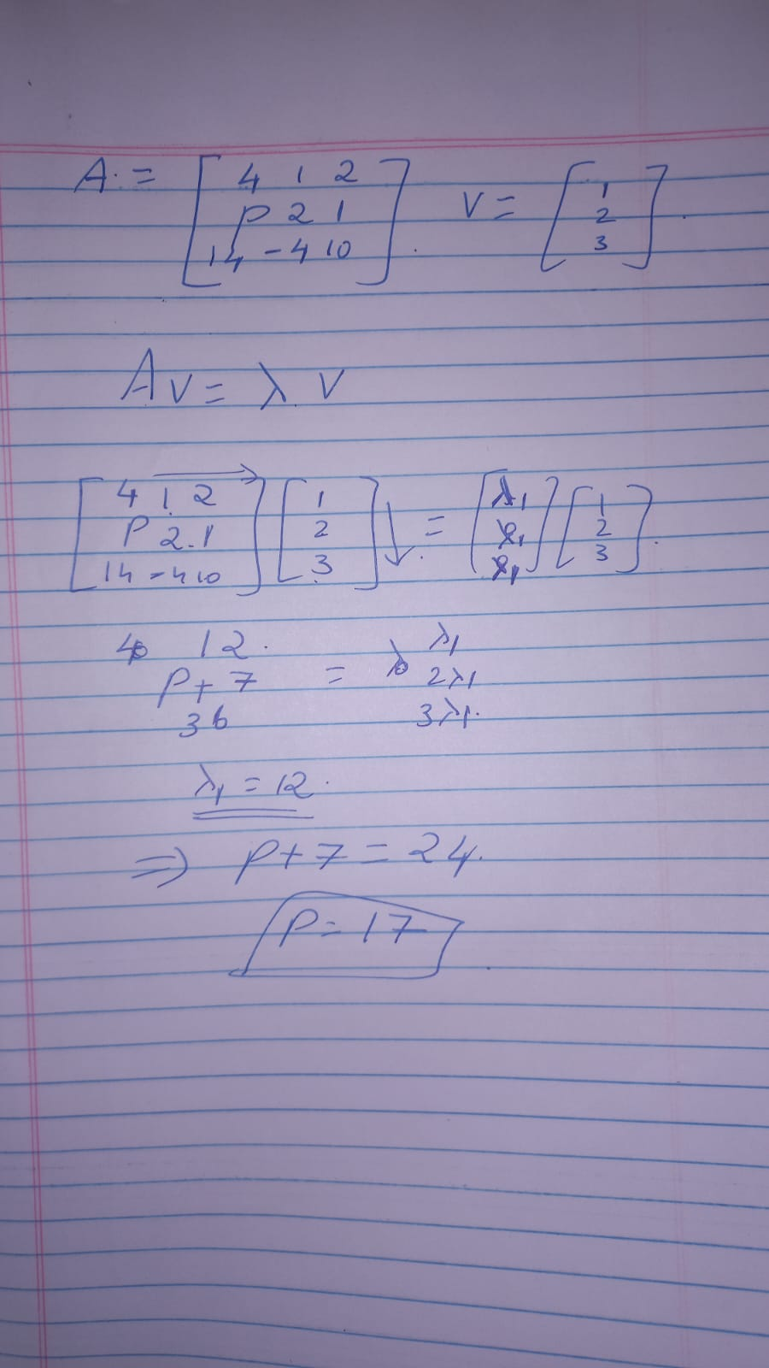
Answer

Slide 47
Applications
The important application of eigenvectors are as follows:
Eigenvectors are used in Physics in simple mode of oscillation
In Mathematics, eigenvector decomposition is widely used in order to solve the linear equation of first order, in ranking matrices, in differential calculus etc
This concept is widely used in quantum mechanics
It is applicable in almost all the branches of engineering
Used in Principal Component Analysis for finding orthogonal vectors

Slide 48
System of Linear Equations

Slide 49
Whats linear eqn?
What is a linear equation?
Substitution method
Elimination Method
Cramers
Matrix representation, reduced row echelon forms
Questions, 1,2(LU decomposition)

Slide 50
What are linear equations?
A linear equation is an equation in which the highest power of the variable is always 1. It is also known as a one-degree equation.
E.g: 2x+y=1
x+2y+3z=4

Slide 51
Methods to solve them
Substitution
Elimination
Cramer’s

Slide 52
Substitution
Reduce two equations with two variables down to a single equation with one variable.
Since each equation in the system has two variables, one way to reduce the number of variables in an equation is to substitute an expression for a variable.
x+y=5; 2x+y = 1
y= 5-x …………….(1)
2x+ 5-x=1 => x = -4
y= 5-(-4) = 9

Slide 53
Elimination
Since each equation in the system has two variables, one way to reduce the number of variables is to add or subtract the two equations in the system to cancel out, or eliminate, one of the variables.
3x−y​=7;
(+)2x+y=8​
5x = 15 => x=3
y= 3x-7…. (1) => y=9-7=2

Slide 54
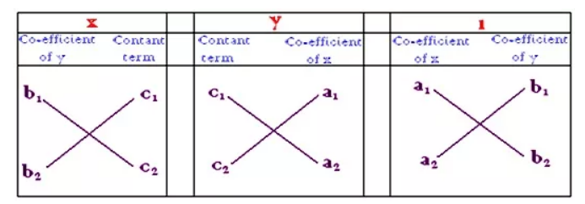
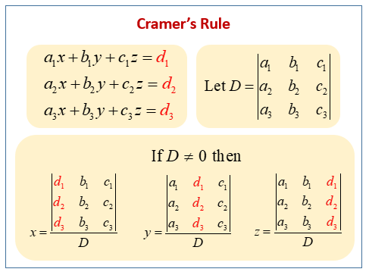
Cramer’s method

Slide 55
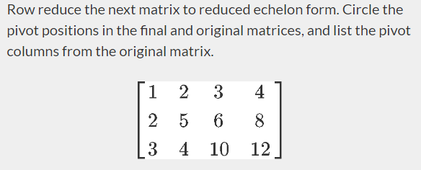
Reduced Row Echelon Form

Slide 56
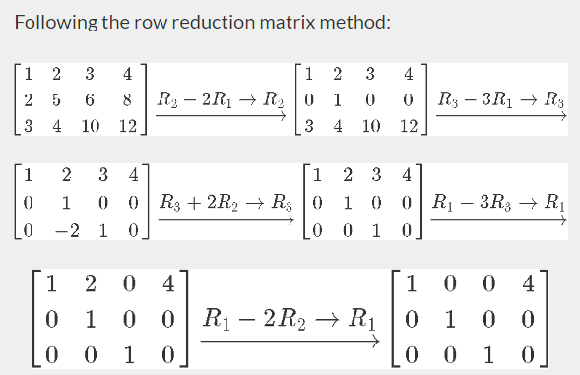
RREF cont..

Slide 57
Q1
A small engineering company has an old machine which produces 30 components per hour and has recently installed a new machine which produces 40 components per hour. Yesterday, both machines were in operation for different periods of time. If 545 components were produced when the total number of hours of operation was 15 hours, determine for how many hours each machine was operating. How could you get the system of equations of this question?

Slide 58
A1

Slide 59
Random Var

Slide 60
What is random var
Types:dicrete, continuous, examples
Binomial random variables, Bernoulli dist mean + var
Poisson distribution, its property
2 question

Slide 61
What is a Random Variable?
A random variable (also called random quantity, aleatory variable, or stochastic variable) is a mathematical formalization of a quantity or object which depends on random events. It is a mapping or a function from possible outcomes
Eg: Random Variable X for a coin toss is 1 if heads or 0 if tails

Slide 62


Types of Random Variables
Discrete Random Variables: The possible outcomes are finite
Continuous Random Variables: The possible outcomes are infinite

Slide 63
Binomial Random Variables
A binomial random variable counts how often a particular event occurs in a fixed number of tries or trials. For a variable to be a binomial random variable, ALL of the following conditions must be met:
The number of observations n is fixed.
Each observation is independent.
Each observation represents one of two outcomes ("success" or "failure").
The probability of "success" p is the same for each outcome.

Slide 64

Bernoulli Distribution, Mean, Variance
The Bernoulli distribution is a special case of the binomial distribution where a single trial is conducted (so n would be 1 for such a binomial distribution).
Mean = p
Variance = p(1-p)

Slide 65



Binomial Variable Mean, Variance
This is the probability of having x successes in a series of n independent trials when the probability of success in any one of the trials is p. If X is a random variable with this probability distribution
Mean = np; Var(X)=npq

Slide 66
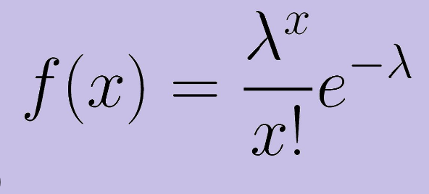
Poisson Distribution
In probability theory and statistics, the Poisson distribution is a discrete probability distribution that expresses the probability of a given number of events occurring in a fixed interval of time or space if these events occur with a known constant mean rate and independently of the time since the last event.

Slide 67
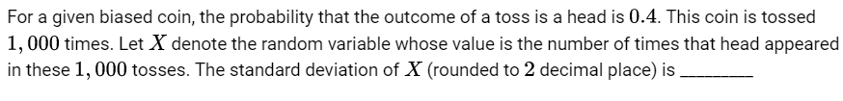
Q1

Slide 68
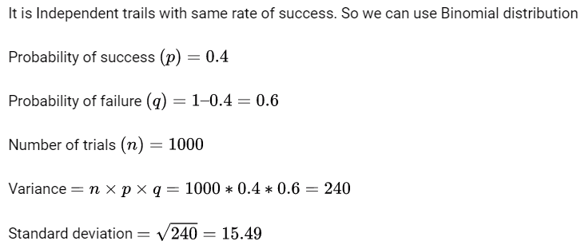
A1

Slide 69
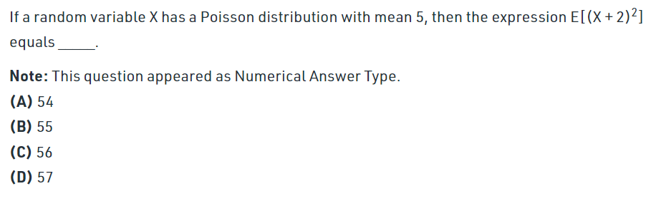
Q2

Slide 70
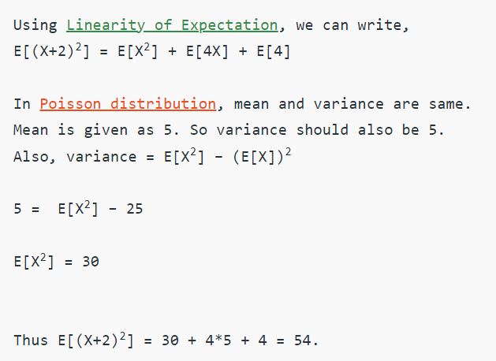
A2

Slide 71
Uniform and Normal Distributions
Suraj Subramanyam
106119128

Slide 72
Uniform Distribution
In statistics, uniform distribution refers to a type of probability distribution in which all outcomes are equally likely. A deck of cards has within it uniform distributions because the likelihood of drawing a heart, a club, a diamond, or a spade is equally likely. A coin also has a uniform distribution because the probability of getting either heads or tails in a coin toss is the same.
The uniform distribution can be visualized as a straight horizontal line, so for a coin flip returning a head or tail, both have a probability p = 0.50 and would be depicted by a line from the y-axis at 0.50.

Slide 73
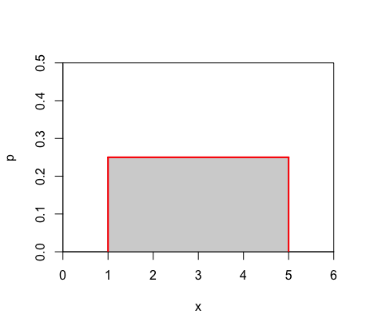
The Graph of Uniform Distribution

Slide 74
Normal Distributions
Normal distribution, also known as the Gaussian distribution, is a probability distribution that is symmetric about the mean, showing that data near the mean are more frequent in occurrence than data far from the mean.
In graphical form, the normal distribution appears as a "bell curve".

Slide 75
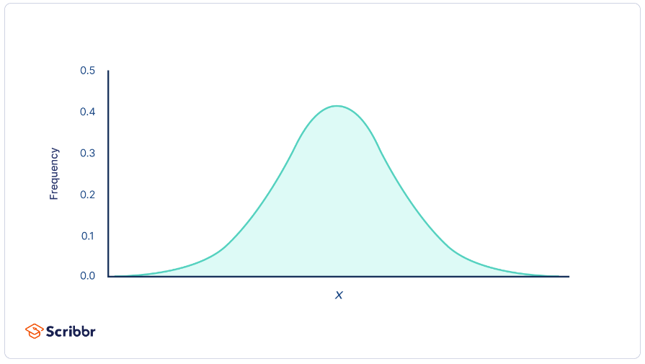
The Graph of Normal Distribution

Slide 76
Why are Normal Distributions Important
All kinds of variables in natural and social sciences are normally or approximately normally distributed. Height, birth weight, reading ability, job satisfaction, or SAT scores are just a few examples of such variables.
Because normally distributed variables are so common, many statistical tests are designed for normally distributed populations.
Understanding the properties of normal distributions means you can use inferential statistics to compare different groups and make estimates about populations using samples.

Slide 77
Properties of Normal Distributions
The mean, median and mode are exactly the same.
The distribution is symmetric about the mean—half the values fall below the mean and half above the mean.
The distribution can be described by two values: the mean and the standard deviation.
The mean is the location parameter while the standard deviation is the scale parameter.

Slide 78
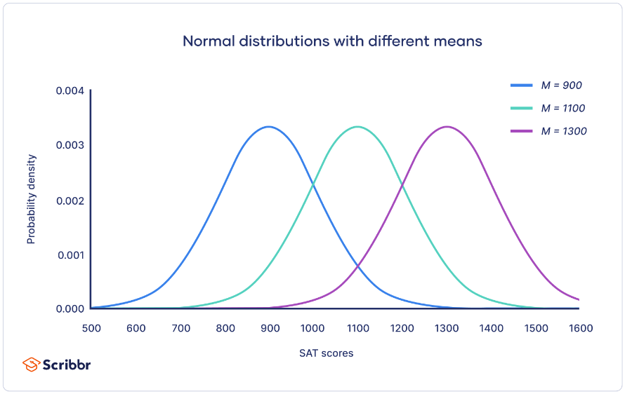
Properties of Normal Distributions

Slide 79
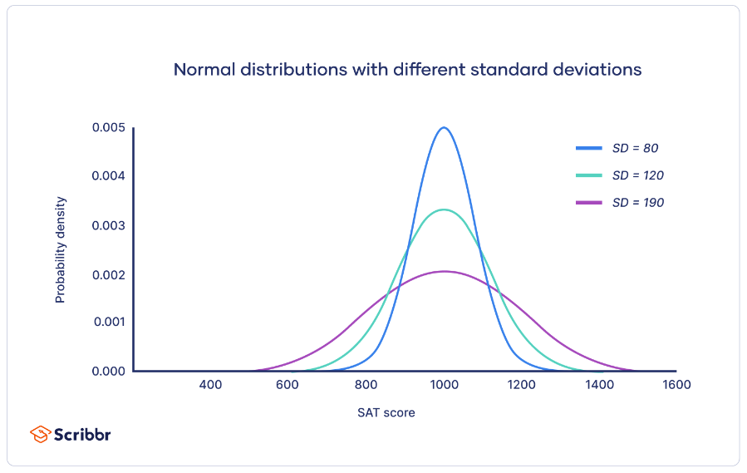
Properties of Normal Distributions

Slide 80

The Formula for Normal Distribution
$$f(x)=\frac{1}{σ\sqrt{2π}}e^{−\frac{(x−μ)^{2}}{2σ^{2}}} \text{for} −∞<x<∞$$

Slide 81
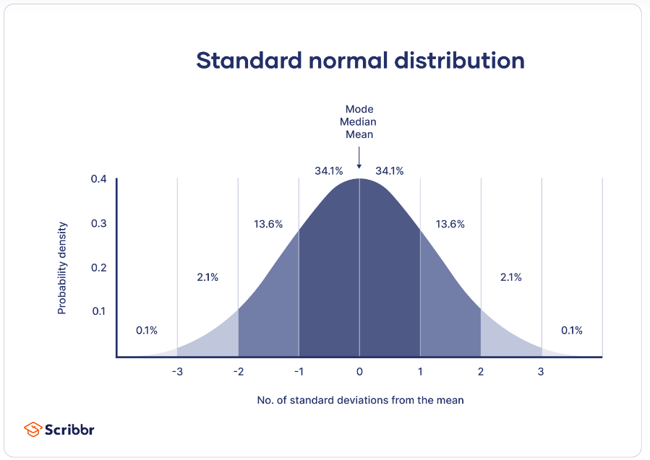
The Standard Normal Distribution
The standard normal distribution, also called the z-distribution, is a special normal distribution where the mean is 0 and the standard deviation is 1.

Slide 82
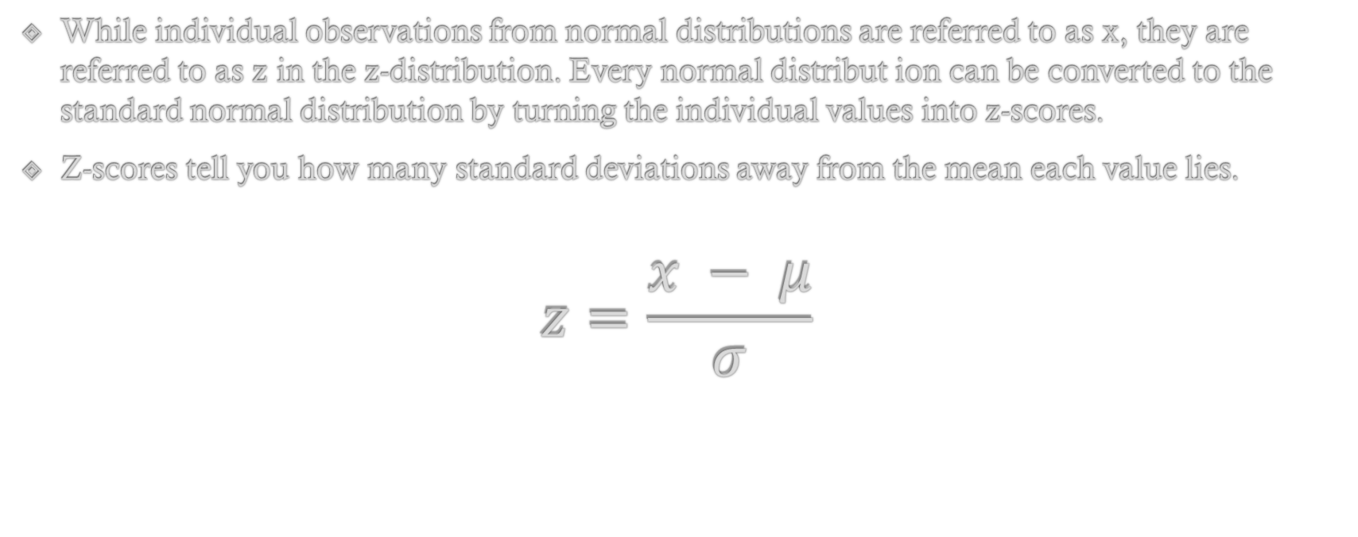
Equation for Standard Normal Distributions
While individual observations from normal distributions are referred to as x, they are referred to as z in the z-distribution. Every normal distribut ion can be converted to the standard normal distribution by turning the individual values into z-scores.
Z-scores tell you how many standard deviations away from the mean each value lies.
$$z=\frac{x − μ}{σ}$$

Slide 83
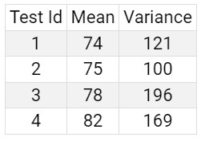
Example Question
In four tests taken by 450 students, marks are found to be normally distributed with mean and variance as given below
A has secured 80 in the first test, 81 in the second, 86 in the third and 89 in the fourth. In which test did A actually perform best relative to other students.
(A)Fourth Test
(B)Third Test
(C)Second Test
(D)First Test

Slide 84

Answer
To find out we have to calculate the performance of student in comparison to other students appearing in the same test
In Test 1, μ1 = 74, σ1 = 11 $z1=\frac{x1 − μ1}{σ1}$ = $\frac{80 −74}{11}$ = 0.545 | In Test 2, μ2 = 75, σ2 = 10 $z2=\frac{x2 − μ2}{σ2}$ = $\frac{81 −75}{10}$ = 0.6
In Test 3, μ3 = 78, σ3 = 14 $z3=\frac{x3 − μ3}{σ3}$ = $\frac{86 −78}{14}$ = 0.571 | In Test 4, μ4 = 82, σ2 = 13 $z4=\frac{x4 − μ4}{σ4}$ = $\frac{89 −82}{13}$ = 0.538
So from this we can conclude that student performed better in 2nd Test relative to other students.

